Slide 1




ACT: Architectural Carbon Modeling Tools
@ MICRO 2022
Tutorial
Udit Gupta

Slide 2

ACT Tutorial: Today
Time | Topic
1:00 – 1:15pm | Introductory remarks
1:15 – 1:30pm | Motivation: Understanding the source of computing’s emissions
1:30 – 2:15pm | Overview of ACT: An Architectural Carbon Modeling Tool
2:15 –2:30pm | Coffee Break
2:30 – 3:00pm | Hands-on ACT demo’s
3:00 – 3:15pm | Extending ACT
3:15 – 3:45pm | Office Hours
3:45 – 4:00pm | Closing remarks
Notes:
Finally, given our understanding of carbon emissions, we will conclude by charting paths for how to design future sustainable computing systems.

Slide 3
ACT Tutorial: Today
Time | Topic
9:00 – 9:15am | Introductory remarks
9:15 – 9:30am | Motivation: Understanding the source of computing’s emissions
9:30 – 10:15am | Overview of ACT: An Architectural Carbon Modeling Tool
10:15 –10:30am | Coffee Break
10:30 – 11:00am | Hands-on ACT demo’s
11:00 – 11:15am | Extending ACT
11:15 – 11:45am | Office Hours
11:45 – 12:00pm | Closing remarks
Notes:
Finally, given our understanding of carbon emissions, we will conclude by charting paths for how to design future sustainable computing systems.

Slide 4
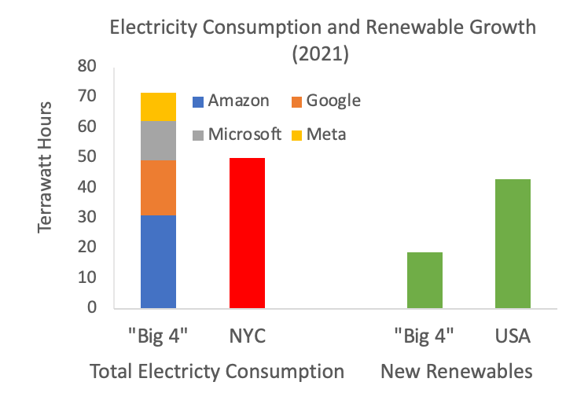
Hyperscalar electricity consumption outpaces renewable growth
Source: Corporate sustainability reports and EIA

Slide 5
Hyperscalar electricity consumption outpaces renewable growth
Source: Corporate sustainability reports and EIA

Slide 6
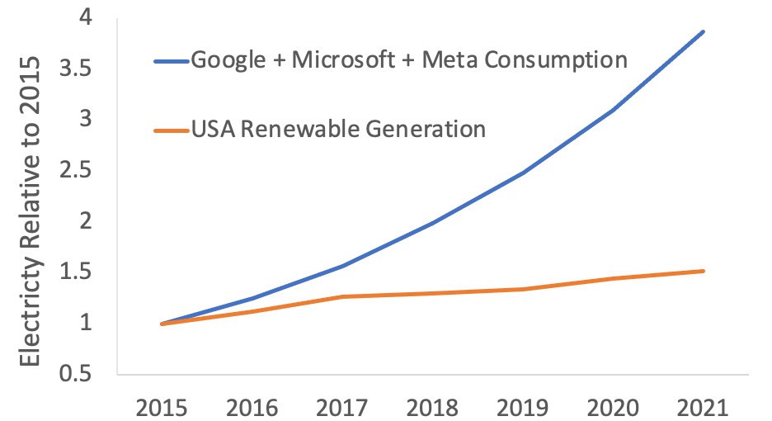
Hyperscalar electricity consumption outpaces renewable growth
Hyperscalar CAGR 25% since 2015
USA Renewables CAGR 7% since 2015
Source: Corporate sustainability reports and EIA

Slide 7
Today
Where does computing’s carbon footprint come from?
Notes:
Specifically we ask the question, where does computing’s carbon footprint come from?
In our journey to answer this question what we found was quite surprising to some of our collaborators that have spent a lot of time thinking about hardware performance and energy efficiency optimizations.

Slide 8




Today
Where does computing’s carbon footprint come from?
Application
Mobile
Data center
Notes:
In particular we found that computing’s carbon footprint comes not only from energy consumed by running applications on hardware

Slide 9

Today
Where does computing’s carbon footprint come from?
A combination of both energy consumed and hardware manufacturing (embodied carbon).
Application
Mobile
Data center
Notes:
But also from manufacturing hardware devices.

Slide 10
Today
Where does computing’s carbon footprint come from?
A combination of both energy consumed and hardware manufacturing (embodied carbon).
Application
Mobile
Data center
Understanding the source of computing’s emissions
Fabs
Notes:
Finally, given our understanding of carbon emissions, we will conclude by charting paths for how to design future sustainable computing systems.

Slide 11
Today
Where does computing’s carbon footprint come from?
A combination of both energy consumed and hardware manufacturing (embodied carbon).
Application
Mobile
Data center
Understanding the source of computing’s emissions
Tackling computing’s emissions bottom up: architectural carbon models
Fabs
Notes:
Finally, given our understanding of carbon emissions, we will conclude by charting paths for how to design future sustainable computing systems.

Slide 12
Today
Where does computing’s carbon footprint come from?
A combination of both energy consumed and hardware manufacturing (embodied carbon).
Application
Mobile
Data center
Understanding the source of computing’s emissions
Tackling computing’s emissions bottom up: architectural carbon models
Tackling computing’s emissions top down: enabling sustainable AI
Fabs
Notes:
Finally, given our understanding of carbon emissions, we will conclude by charting paths for how to design future sustainable computing systems.

Slide 13

Today
Where does computing’s carbon footprint come from?
A combination of both energy consumed and hardware manufacturing (embodied carbon).
Application
Mobile
Data center
Understanding the source of computing’s emissions
Tackling computing’s emissions bottom up: architectural carbon models
Tackling computing’s emissions top down: enabling sustainable AI
How can we curve computing’s emissions and enable sustainable computing (going beyond efficiency optimizations)?
Fabs
Notes:
Finally, given our understanding of carbon emissions, we will conclude by charting paths for how to design future sustainable computing systems.

Slide 14
Today
Where does computing’s carbon footprint come from?
A combination of both energy consumed and hardware manufacturing (embodied carbon).
Application
Mobile
Data center
Understanding the source of computing’s emissions
Tackling computing’s emissions bottom up: architectural carbon models
Tackling computing’s emissions top down: enabling sustainable AI
How can we curve computing’s emissions and enable sustainable computing (going beyond efficiency optimizations)?
Fabs
Notes:
Finally, given our understanding of carbon emissions, we will conclude by charting paths for how to design future sustainable computing systems.

Slide 15
Life Cycle Analysis: key to understanding carbon emissions
Notes:
To study the breakdown of carbon emissions in mobile devices, we will use life cycle analyses or LCAs.
LCAs are frequently used to quantify the emissions across four phases of products.
This includes hardware systems.
The first phase is manufacturing the product, or hardware platform.

Slide 16
Life Cycle Analysis: key to understanding carbon emissions
Notes:
The second is transporting it from fabs to users.

Slide 17
Life Cycle Analysis: key to understanding carbon emissions
Notes:
The third is using the hardware mobile device.

Slide 18
Life Cycle Analysis: key to understanding carbon emissions
Notes:
The final phase is recycling and end of hardware life processing.
Portions of the hardware platforms can be repurposed for future iterations.

Slide 19
Life Cycle Analysis: key to understanding carbon emissions
Energy consumption
Focus of systems, software, and hardware designers
“Opex”
Notes:
When considering the carbon footprint of computing systems, systems, software, and hardware designers typically focus on product use or energy consumption.

Slide 20
Life Cycle Analysis: key to understanding carbon emissions
Hardware manufacturing
Energy consumption
Emissions from fabs building chips
Focus of systems, software, and hardware designers
Overheads from infrastructure related activities
Overheads from operational energy consumption
“Capex”
“Opex”
Notes:
However, through our analysis we find that for many use cases hardware manufacturing also contributes a significant portion of emissions to the overall hardware life cycle.
Where emissions from hardware use can be seen as opex-related emissions, we can think of emissions from manufacturing as capex-related footprint.

Slide 21
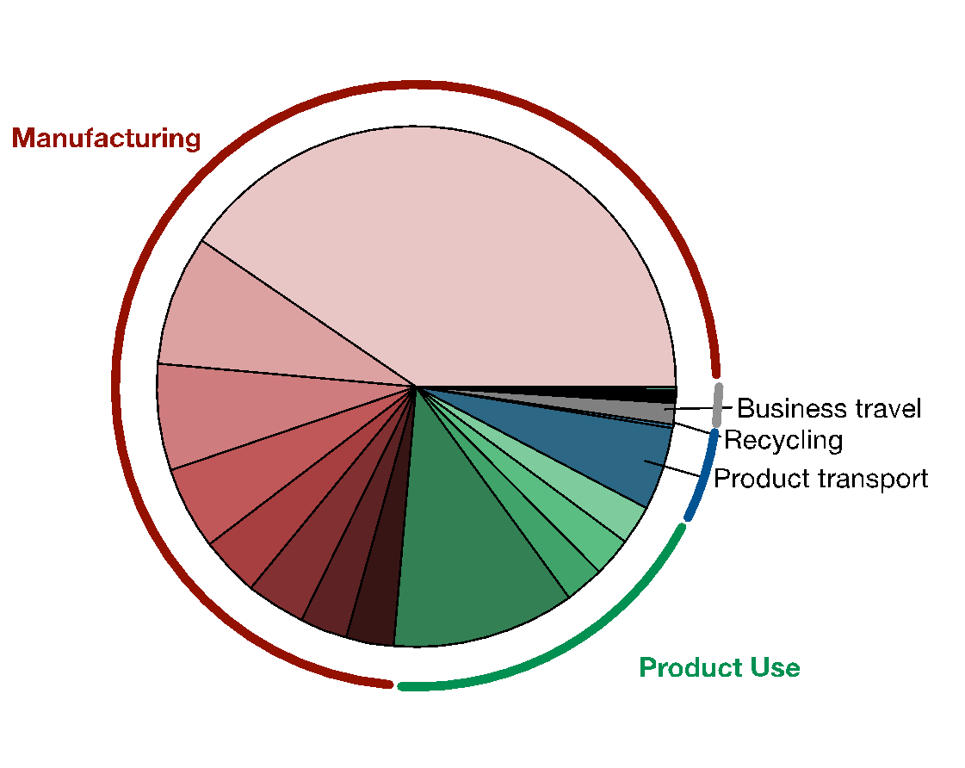
Manufacturing dominates Apple’s overall carbon footprint
Notes:
Here we look at the breakdown of Apple’s overall company-level footprint of 25 million metric tons of CO2 in 2019.
The hardware life cycle emissions are broken down into manufacturing shown in red, product use in green, transport in blue, and recycling in black.
In fact life cycle emissions account for nearly 98% of Apple’s footprint.

Slide 22
Manufacturing dominates Apple’s overall carbon footprint
Manufacturing accounts for 74% of Apple’s end to end breakdown in 2019
Notes:
As shown in red, Manfuacturing accounts for 74% of Apple’s end to end breakdown in 2019.

Slide 23
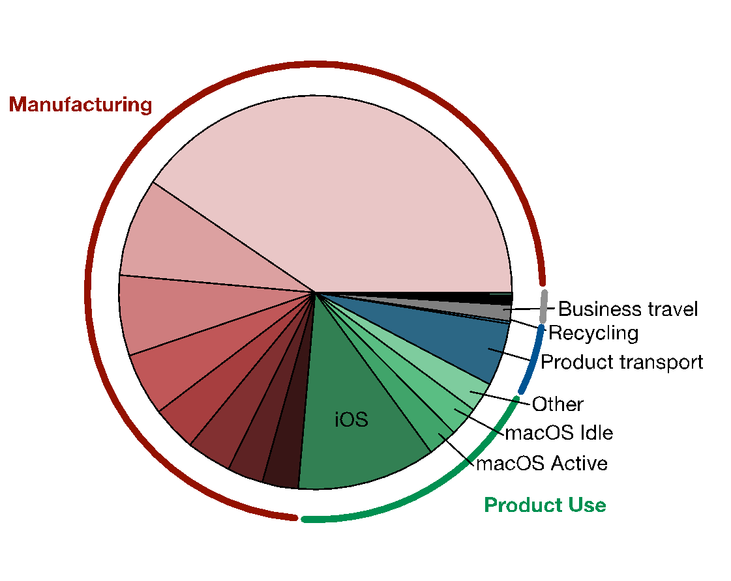
Manufacturing dominates Apple’s overall carbon footprint
Manufacturing accounts for 74% of Apple’s end to end breakdown in 2019
Notes:
Hardware use accounts for 19% of emissions.
Here, we find the majority of emissions are devoted to iOS devices like phones and tablets followed by macOS.
This includes emissions over the course of the entire life time of devices – typically 3 years for mobile phones.

Slide 24
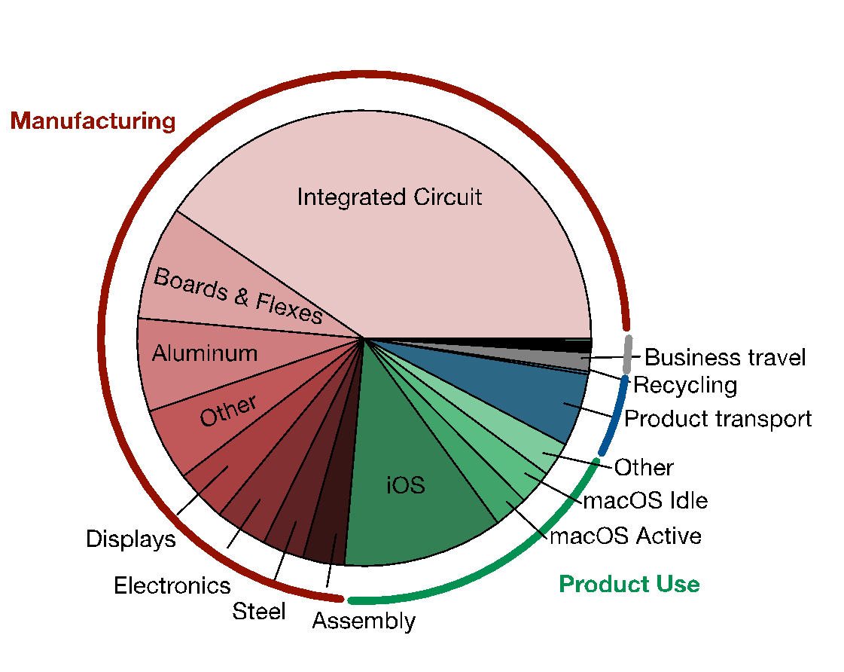
Manufacturing dominates Apple’s overall carbon footprint
Integrated circuits account for 33% of emissions (SoCs, DRAMs, NAND Flash)
Manufacturing accounts for 74% of Apple’s end to end breakdown in 2019
Notes:
Within the manufacturing emissions, we find integrated circuits account for 33% of emissions.
This is more than the emissions due to boards/flexes, aluminum, displays, and other electronics.
These emissions are largely due to SoCs, DRAMs, NAND Flash components in mobile devices --- directly related to hardware design and development.

Slide 25
Manufacturing dominates Apple’s overall carbon footprint
Integrated circuits account for 33% of emissions (SoCs, DRAMs, NAND Flash)
Manufacturing accounts for 74% of Apple’s end to end breakdown in 2019
Aggregating across hundreds of millions of phones, iPads, and other consumer devices sold every year!
“Chasing Carbon: The Elusive Environmental Footprint of Computing” Gupta et. al. (HPCA 2021) https://arxiv.org/abs/2011.02839
Notes:
Now, these emissions are aggregated across hundreds of millions of phones, iPADs, and other consumer devices sold each year.
Next, we study the emission breakdowns for individual hardware platforms.

Slide 26
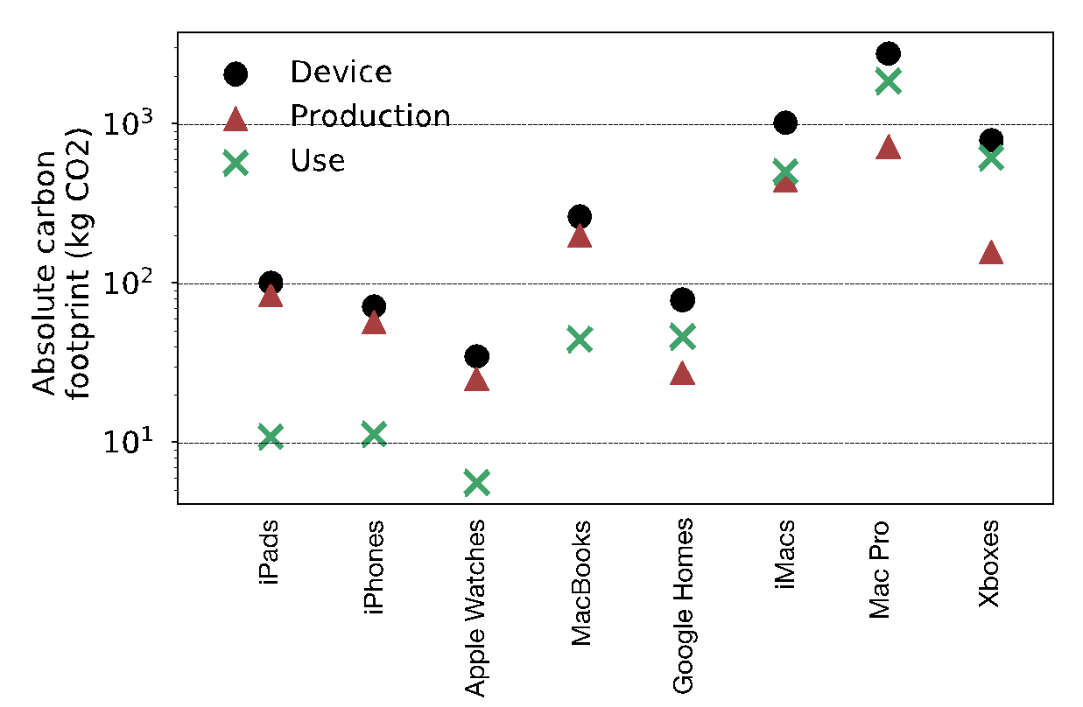
Carbon footprint characteristics vary across devices
Data from public industry validated sustainability reports and life cycle analyses
Battery operated
Plugged in
Notes:
So here we look at the carbon footprint breakdown of mobile devices.
On the x-axis we have 8 mobile devices. The first four are battery operated like iPads, iPhones, Apple Watches, and Laptops.
The last four are always connected or plugged in devices like personal assistants, desktops and gaming stations.
On the y-axis we have the absolute carbon footprint in log scale.
In black we see the end to end life cycle emissions, in red the manufacturing portion, and in green the emissions from hardware use and energy consumption.

Slide 27
Carbon footprint characteristics vary across devices
Data from public industry validated sustainability reports and life cycle analyses
Roughly 75% life cycle emissions for battery operated devices comes from hardware manufacturing.
Battery operated
Plugged in
Notes:
Across the battery operated devices we find that roughly 75% of emissions come from hardware manufacturing.

Slide 28
Carbon footprint characteristics vary across devices
Data from public industry validated sustainability reports and life cycle analyses
Roughly 75% life cycle emissions for battery operated devices comes from hardware manufacturing.
Emissions for always-connected devices come mainly from energy consumption
Battery operated
Plugged in
Notes:
On the other hand for plugged in devices we find the majority of emissions coming from energy consumption and roughly one third the footprint comes from hardware manufacturing.
We attribute the differences in carbon footprint breakdown across battery operated and always-connected devices to come from varying user behaviors such as frequency of use, different types of workloads, idle and sleep cycles, lifetime of hardware, and so on.
Another interesting point we see from this analysis is that the overall and manufacturing-related carbon footprints are not one-time, static costs.
Instead, they scale with hardware resources available in each platform.
In the paper you can find additional details about the carbon footprint breakdown across an even wider range of devices.
But for now, what I want to look at is another cross-section of this design space. Namely, how the carbon footprint of devices has been scaling over time.
### For example, the Mac Pro desktop without displays comprises the largest footprint given it comprises the largest hardware resources in terms of SoC capabilities, memory, and storage.

Slide 29
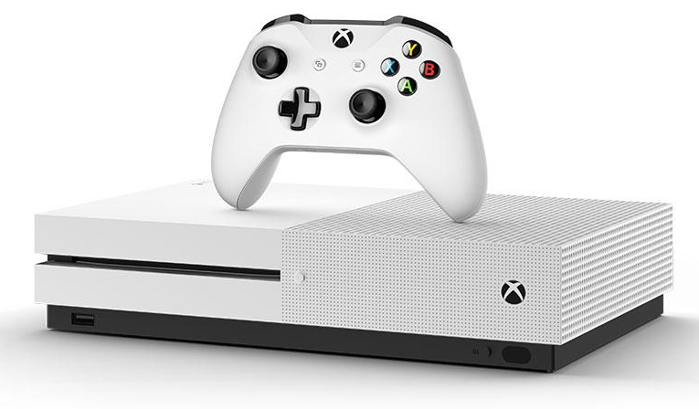
Carbon footprint characteristics vary across devices
Data from public industry validated sustainability reports and life cycle analyses
Roughly 75% life cycle emissions for battery operated devices comes from hardware manufacturing.
Emissions for always-connected devices come mainly from energy consumption
¹ Xbox Standby mode consumes 4 billion kWh
¹ “Latest Game Consoles: Environmental Winners or Losers?” National Resources Defense Council. Noah Horowitz
Battery operated
Plugged in
Notes:
On the other hand for plugged in devices we find the majority of emissions coming from energy consumption and roughly one third the footprint comes from hardware manufacturing.
We attribute the differences in carbon footprint breakdown across battery operated and always-connected devices to come from varying user behaviors such as frequency of use, different types of workloads, idle and sleep cycles, lifetime of hardware, and so on.
Another interesting point we see from this analysis is that the overall and manufacturing-related carbon footprints are not one-time, static costs.
Instead, they scale with hardware resources available in each platform.
In the paper you can find additional details about the carbon footprint breakdown across an even wider range of devices.
But for now, what I want to look at is another cross-section of this design space. Namely, how the carbon footprint of devices has been scaling over time.
### For example, the Mac Pro desktop without displays comprises the largest footprint given it comprises the largest hardware resources in terms of SoC capabilities, memory, and storage.

Slide 30

Greenhouse gas (GHG) Protocol
Technology company
Notes:
To study the breakdown of carbon emissions at the data center scale we use the green house gas protocol.
The GHG protocol is used by many companies including technology companies like Google, Facebook, Apple, Microsoft, and others.
The GHG protocol categories emissions into three main scopes.

Slide 31
Greenhouse gas (GHG) Protocol
Scope 1
Diesel, gas, refrigerant from facilities
Company-owned transport
Technology company
Notes:
First, Scope 1 quantifies emissions directly from burning diesel, gas, and refrigerants in facilities.

Slide 32
Greenhouse gas (GHG) Protocol
Scope 1
Diesel, gas, refrigerant from facilities
Company-owned transport
Scope 2
Purchased energy (renewables)
Technology company
Notes:
Scope 2 quantifies the emissions from purchased energy.
This includes the impact of buying renewable energy sources to offset the net or average carbon footprint from energy being consumed by data centers.
This net emission factor does not ensure that every unit of energy consumed by data centers comes from renewable energy but rather the average carbon intensity of energy consumed.

Slide 33
Greenhouse gas (GHG) Protocol
Scope 1
Diesel, gas, refrigerant from facilities
Company-owned transport
Scope 3 (Upstream)
Hardware and racks
Data center construction
Business travel
Scope 2
Purchased energy (renewables)
Technology company
Notes:
Finally, we have Scope 3 which comprises emissions from the supply chain.
Depending on the company, the supply chain can be separated into the upstream and down-stream supply chain.
The upstream primarily includes capital and purchased goods, business travel, and infrastructure setup.

Slide 34
Greenhouse gas (GHG) Protocol
Scope 1
Diesel, gas, refrigerant from facilities
Company-owned transport
Scope 3 (Upstream)
Hardware and racks
Data center construction
Business travel
Scope 3 (Downstream)
Use of sold goods
Transportation and distribution
Scope 2
Purchased energy (renewables)
Technology company
Notes:
On the other hand, the down stream supply chain and Scope 3 emissions comprise the use of sold goods and transportation and distribution of goods.
Note that in the context of data center oriented technology companies like Facebook and Google, Scope 3 emissions ar edominate dby the upstream footprint.

Slide 35
Greenhouse gas (GHG) Protocol
Scope 1
Diesel, gas, refrigerant from facilities
Company-owned transport
Scope 3 (Upstream)
Hardware and racks
Data center construction
Business travel
Scope 3 (Downstream)
Use of sold goods
Transportation and distribution
Scope 2
Purchased energy (renewables)
Technology company
Scope 2 emissions come from opex-related activities
Scope 1 and Scope 3 emissions come from capex-related activities
Notes:
Note that, in terms of data centers, Scope 2 emissions come from opex—related activities.
On the other hand, Scope 1 and Scope 3 emissions come from capex-related activites.

Slide 36
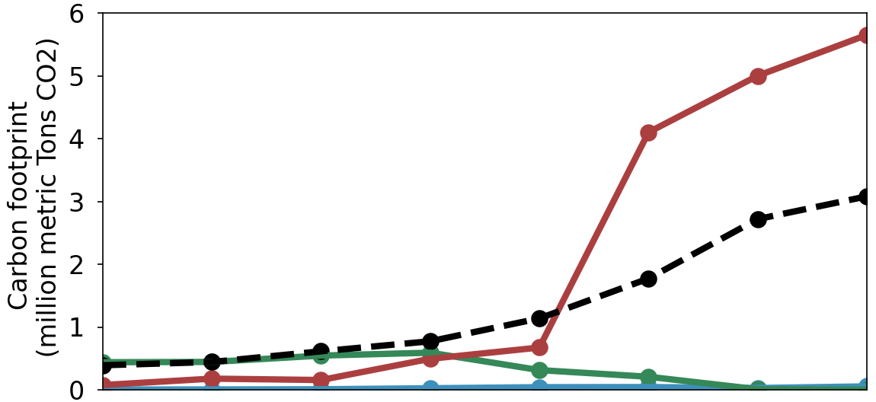
Historical analysis of Facebook’s carbon footprint
Scope 1 - Capex
Scope 2 - Opex
Scope 3 - Capex
Location-based Emissions
2014
2015
2016
2017
2018
2019
2020
2021
Notes:
Here we look at the historical trends in Facebook’s carbon footprint using the GHG protocol.
In blue we see net Scope 1 emissions.
In green, net Scope 2 emissions.
In red, net Scope 3 emissions.
On the x-axis we look at the breakdown between 2014 to 2019.

Slide 37
Historical analysis of Facebook’s carbon footprint
Scope 1 - Capex
Scope 2 - Opex
Scope 3 - Capex
Impact of renewable energy in data centers
2014
2015
2016
2017
2018
2019
2020
2021
Notes:
On the far right, we see the impact of Facebook purchasing renewable energy as the difference between the black dashed line and the green. We see Scope 2 emissions greatly reduce upon powering data centers with renewable energy.

Slide 38
Historical analysis of Facebook’s carbon footprint
Scope 1 - Capex
Scope 2 - Opex
Scope 3 - Capex
Scope 3 (capex) dominates Facebook’s carbon emissions.
49% of Scope 3 comes from hardware, infrastructure, data center construction
Impact of renewable energy in data centers
2014
2015
2016
2017
2018
2019
2020
2021
Notes:
Following the mobile analysis, we find that Scope 3 dominates Facebook’s carbon emissions.

Slide 39
Historical analysis of Facebook’s carbon footprint
Scope 1 - Capex
Scope 2 - Opex
Scope 3 - Capex
Scope 3 (capex) dominates Facebook’s carbon emissions.
49% of Scope 3 comes from hardware, infrastructure, data center construction
Change in HW footprint disclosure practice
Impact of renewable energy in data centers
2014
2015
2016
2017
2018
2019
2020
2021
Notes:
Interestingly we see a large increase in Facebook’s Scope 3 emissions between 2018 and 2019.
The increase is primarily due to a change in hardware footprint disclosure practices.
In particular prior to 2018, the carbon footprint related to emissions from manufacturing servers found in the data center were not included.
After 2018, hardware manufacturing emissions began to be included causing a stark rise in Scope 3 emissions.
The change disclosure practices highlight the need to motivate companies to report their carbon emissions over time.
In fact, we see similar trends across other data center oriented companies, like Google as outline din the paper below.

Slide 40
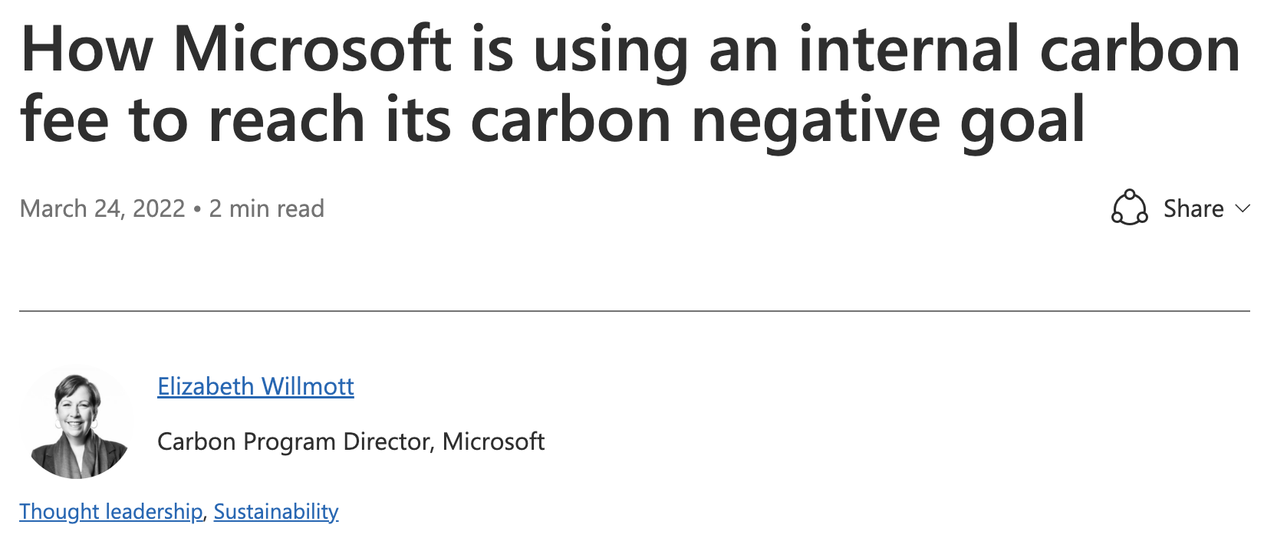
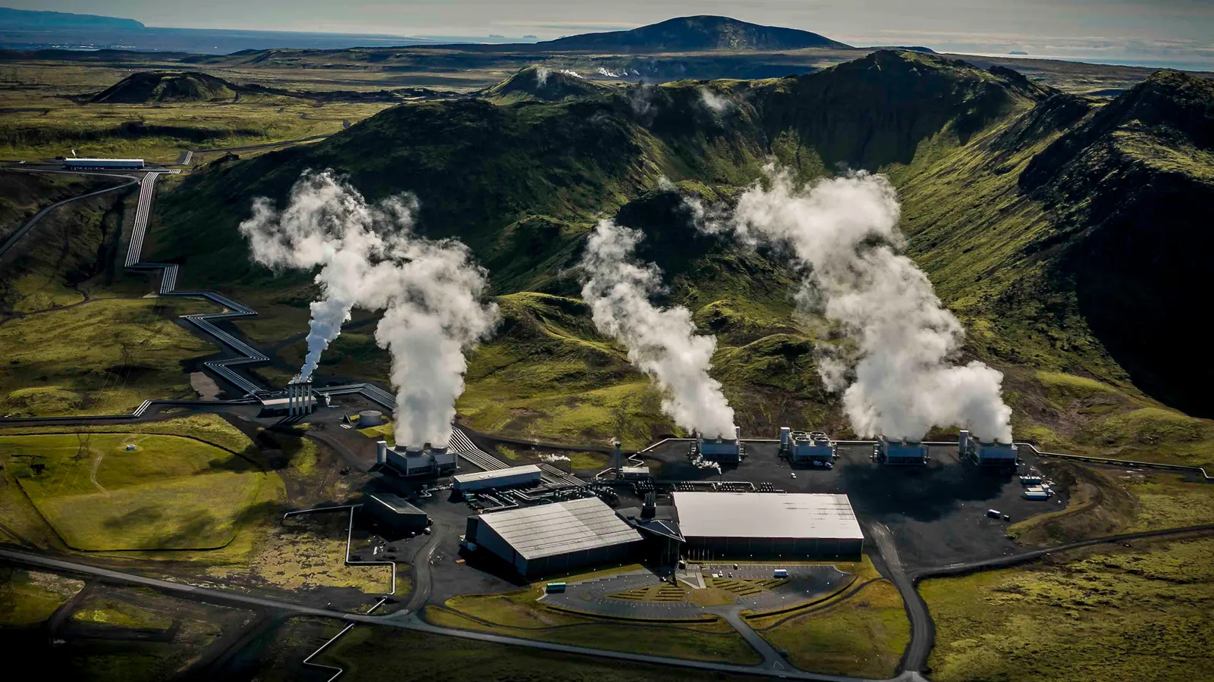
Addressing Scope 3: Economic incentives and Carbon Sequestration
Microsoft: $100/tCO2e to incentivize reductions
Google: Estimates $50-$300/tCO2e as carbon sequestration scales, up to 20% of the cost of a server!
https://cloudblogs.microsoft.com/industry-blog/sustainability/2022/03/24/how-microsoft-is-using-an-internal-carbon-fee-to-reach-its-carbon-negative-goal/
https://www.youtube.com/watch?v=W7uTbxCxmPg

Slide 41
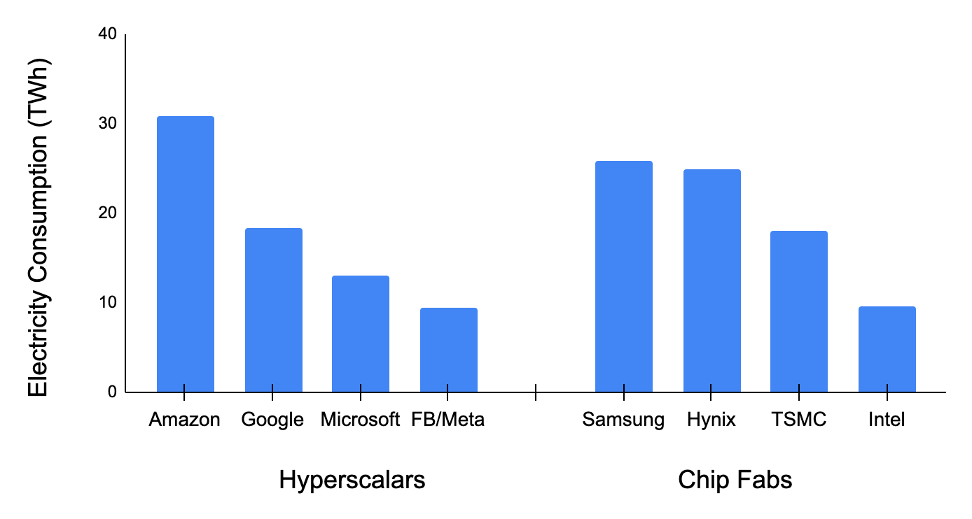
Chip manufacturing is energy intensive
Hyperscalar CAGR 25% since 2015
“Fab 4” CAGR 11% since 2015
USA Renewables CAGR 7% since 2015
Source: 2021 corporate sustainability reports

Slide 42

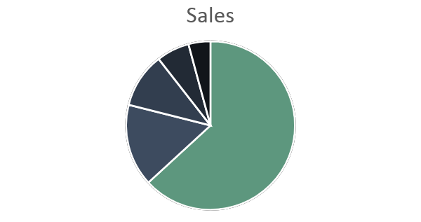
Semiconductor fab
Wafer & gas (10%)
PFCs (10%)
Energy
(60%)
Chemicals (15%)
Gupta et. al. Chasing Carbon: The Elusive Environmental Footprint of Computing (HPCA 2021)

Slide 43


Semiconductor fab
100% Renewable powered semiconductor fab
Wafer & gas (10%)
PFCs (10%)
Energy
(60%)
Chemicals (15%)
Reduces manufacturing footprint by 2.5x
Gupta et. al. Chasing Carbon: The Elusive Environmental Footprint of Computing (HPCA 2021)

Slide 44
“Green” powered fabs are not enough
Semiconductor fab
100% Renewable powered semiconductor fab
TSMC plans for
25% renewable by 2025 and 100% renewable by 2050.
Wafer & gas (10%)
PFCs (10%)
Energy
(60%)
Chemicals (15%)
Reduces manufacturing footprint by 2.5x
Gupta et. al. Chasing Carbon: The Elusive Environmental Footprint of Computing (HPCA 2021)

Slide 45
Today
Where does computing’s carbon footprint come from?
A combination of both energy consumed and hardware manufacturing (embodied carbon).
Application
Mobile
Data center
Understanding the source of computing’s emissions
Tackling computing’s emissions bottom up: architectural carbon models
Tackling computing’s emissions top down: enabling sustainable AI
How can we curve computing’s emissions and enable sustainable computing (going beyond efficiency optimizations)?
Fabs
Notes:
Finally, given our understanding of carbon emissions, we will conclude by charting paths for how to design future sustainable computing systems.

Slide 46
Tackling computing’s carbon footprint requires optimizing emissions across hardware life cycles (manufacturing and operational use)
Notes:
How have these advances affected computing’s overall environmental sustainability and more specifically carbon footprint.

Slide 47
Tackling computing’s carbon footprint requires optimizing emissions across hardware life cycles (manufacturing and operational use)
But (unlike performance, power, energy) there is a distinct lack of architectural tools and infrastructure to quantify carbon
Notes:
How have these advances affected computing’s overall environmental sustainability and more specifically carbon footprint.

Slide 48
Architectural Carbon Modeling Tools (ACT)
Arch. Carbon Model
Carbon–aware HW design metrics

Slide 49

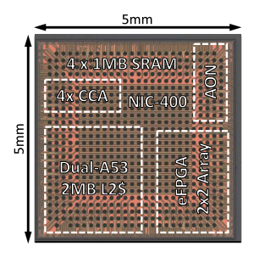
Architectural Carbon Modeling Tools (ACT)
Fab
Environmental
SW design &
performance
Arch. Carbon Model
Carbon–aware HW design metrics
HW design &
power

Slide 50
Architectural Carbon Modeling Tools (ACT)
Fab
Environmental
SW design &
performance
Arch. Carbon Model
Carbon–aware HW design metrics
Operational CO₂
Embodied CO₂
HW design &
power
CO₂ -aware
HW optimization

Slide 51
Architectural Carbon Model
Model
Hardware/software input

Slide 52

Architectural Carbon Model
Model
Hardware/software input
Performance/power/energy and
lifetime of hardware

Slide 53


Architectural Carbon Model
Model
Hardware/software input
Performance/power/energy and
lifetime of hardware
Energy efficiency and
environment (carbon intensity)

Slide 54
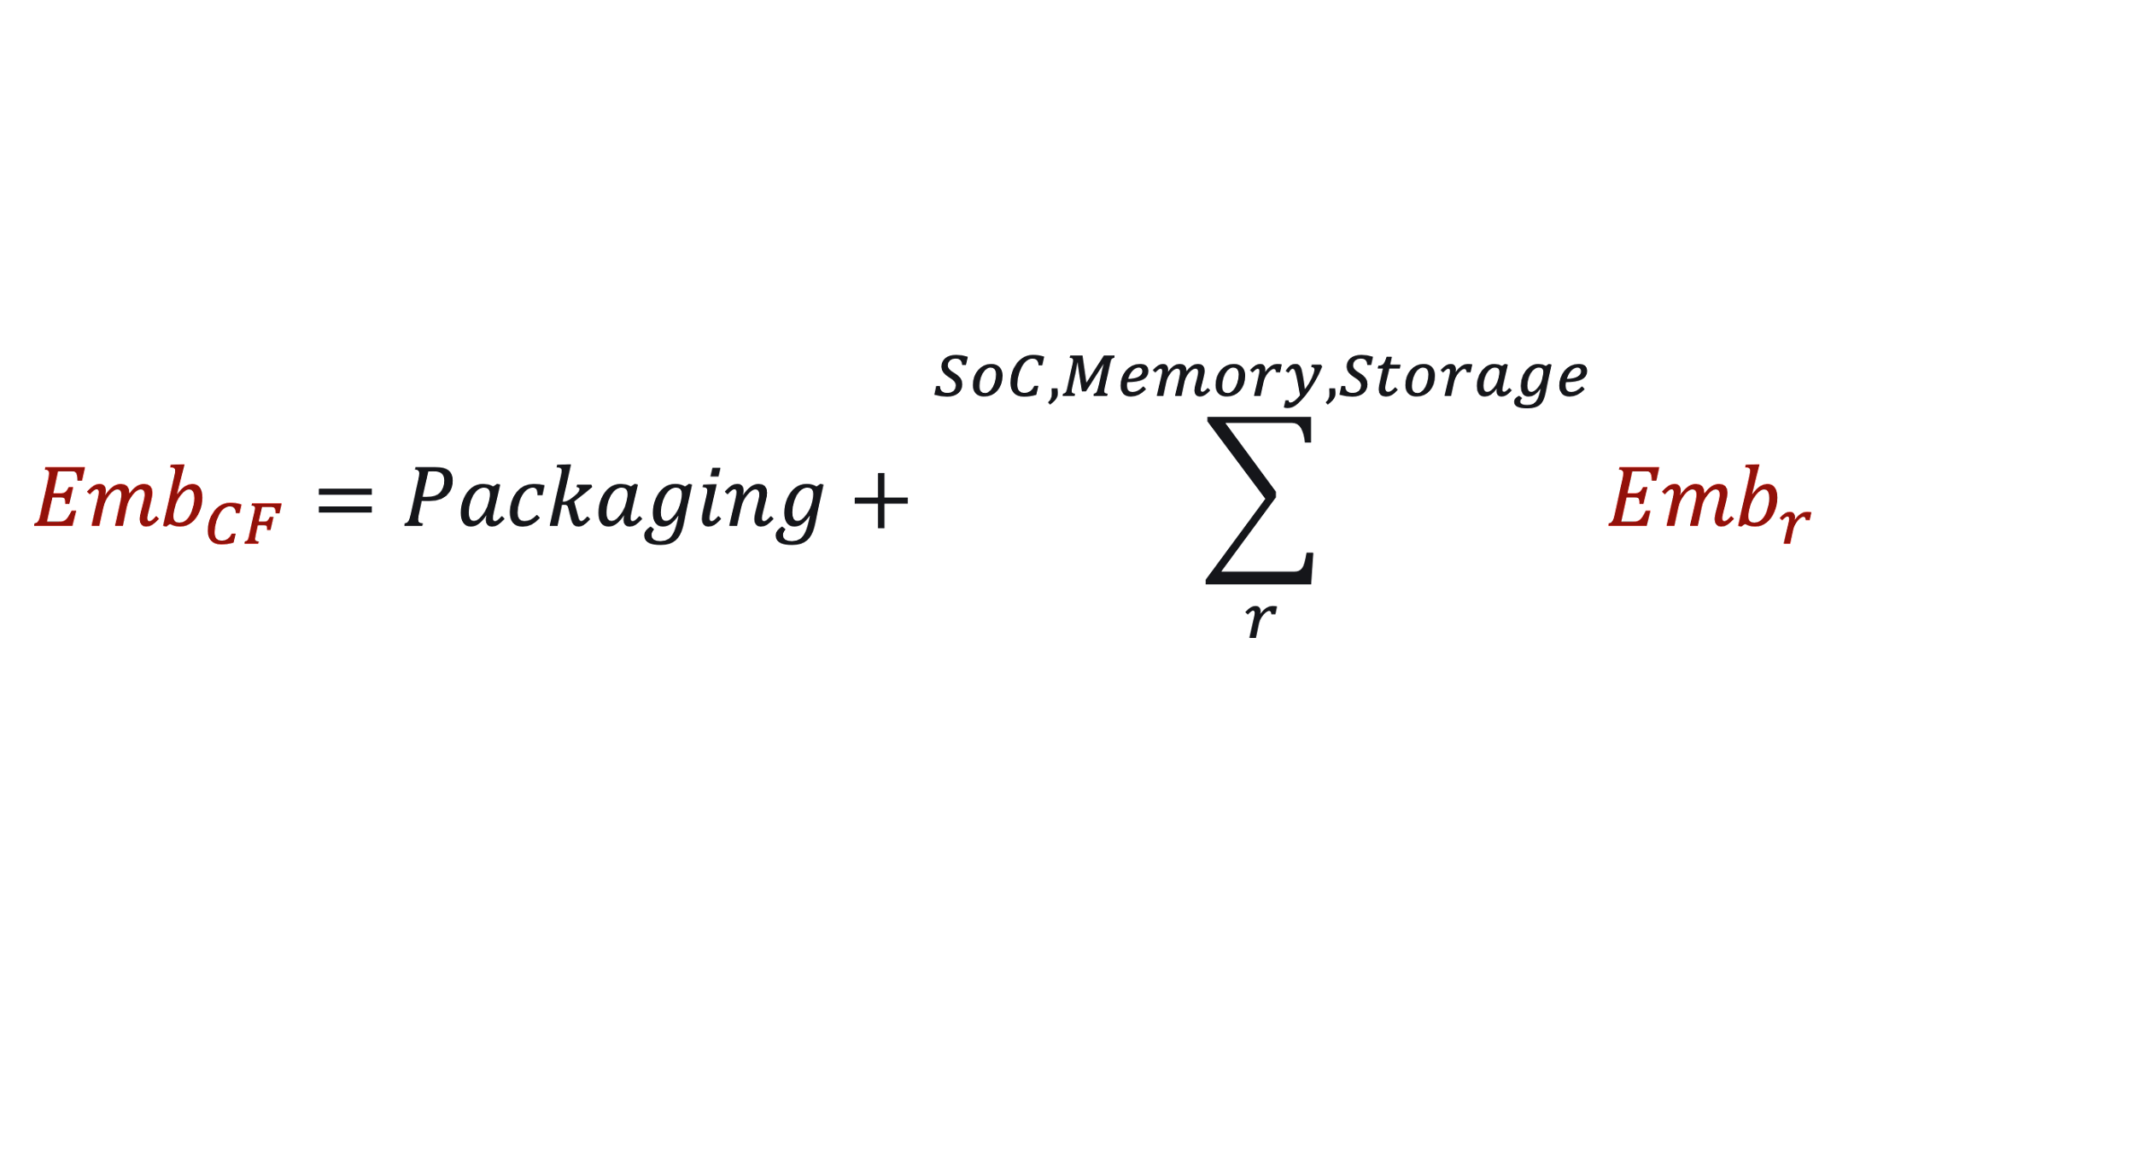
Architectural Carbon Model
Model
Hardware/software input
Performance/power/energy and
lifetime of hardware
Energy efficiency and
environment (carbon intensity)
Overhead of hardware
manufacturing

Slide 55
Embodied carbon of application processors (SoC’s)
Notes:
We add the energy, chemicals, and materials used by the fab.
And factor in yield of manufacturing

Slide 56
Embodied carbon of application processors (SoC’s)
Energy
source (grid)
Device and fab characterization
(industry fabs, device data)
Hardware design

Slide 57

Embodied carbon of application processors (SoC’s)

Slide 58
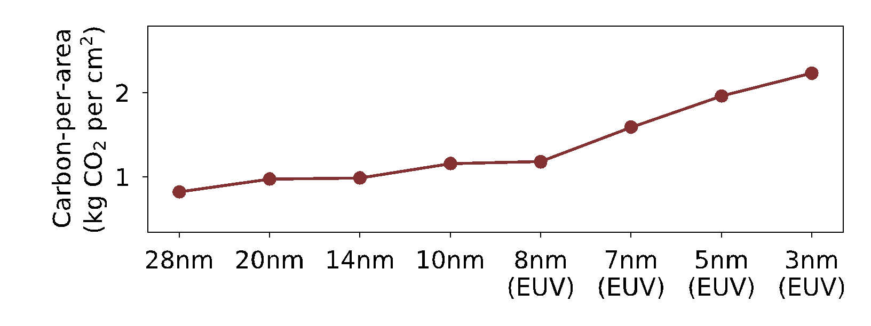
Embodied carbon of application processors (SoC’s)
Data sources:
[IMEC] DTCO including Sustainability: Power-Performance-Area-Cost-Environmental score (PPACE) Analysis for Logic Technologies. Bardon et. al (IEDM 2020)
[TSMC] TSMC Sustainability Reports 2018-2020

Slide 59
Embodied carbon of application processors (SoC’s)
Fab with coal
(0% renewable)
Fab with solar (100% renewable)
Data sources:
[IMEC] DTCO including Sustainability: Power-Performance-Area-Cost-Environmental score (PPACE) Analysis for Logic Technologies. Bardon et. al (IEDM 2020)
[TSMC] TSMC Sustainability Reports 2018-2020

Slide 60
Embodied carbon of application processors (SoC’s)
Fab with coal
(0% renewable)
TSMC 2025 goal
(25% renewable)
Fab with solar (100% renewable)
Data sources:
[IMEC] DTCO including Sustainability: Power-Performance-Area-Cost-Environmental score (PPACE) Analysis for Logic Technologies. Bardon et. al (IEDM 2020)
[TSMC] TSMC Sustainability Reports 2018-2020

Slide 61

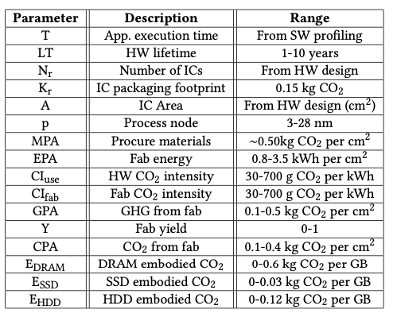

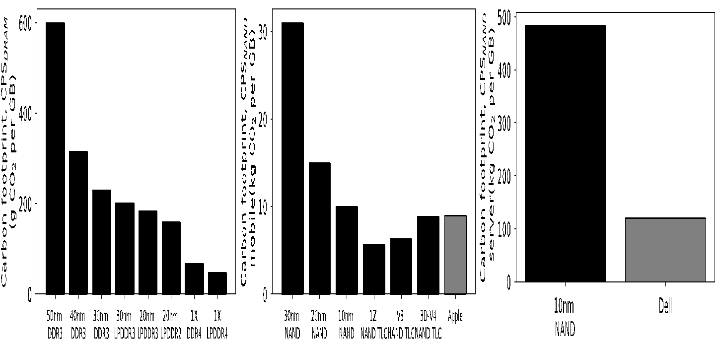
Additional details found in the paper…
Memory and storage
ACT parameters
DRAM
SSD
Data sources: SK Hynix, Apple
Notes:
We take a similar approach for modeling emissions for memory and storage units which can be found in the paper.

Slide 62
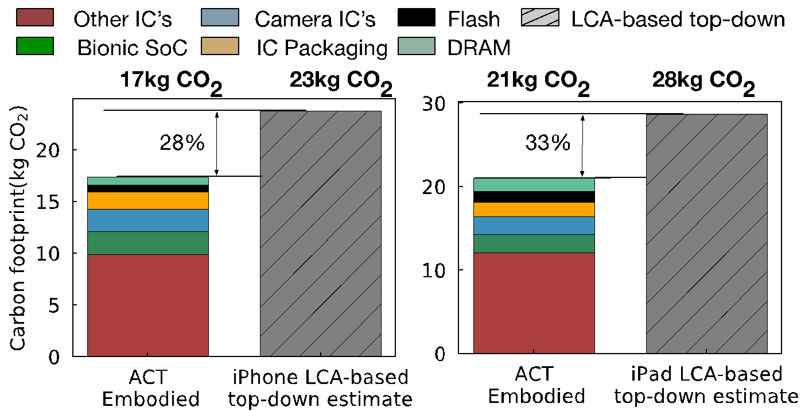
Comparing ACT with Apple’s product environmental reports
ACT embodied
estimate
Apple iPhone
estimates
ACT embodied
estimate
Apple iPad
estimates

Slide 63
Comparing ACT with Apple’s product environmental reports
ACT embodied
estimate
Apple iPhone
estimates
ACT embodied
estimate
Apple iPad
estimates

Slide 64

Tenets of Environmental Design
Reduce
Design leaner footprint software and hardware.
Recycle
Reuse
Recover discarded systems and components.
Repurpose systems already produce.

Slide 65
Tenets of Environmental Design
Reduce
Design leaner footprint software and hardware.
Recycle
Reuse
Recover discarded systems and components.
Repurpose systems already produce.

Slide 66
Reuse: General purpose versus custom mobile HW
AI inference case study (MobileNet) assuming 3 year hardware lifetime, and same utilization in all cases
Commodity (mobile CPU)
Specialized (mobile GPU, DSP)
Architectural
Carbon Model
Carbon per inference

Slide 67
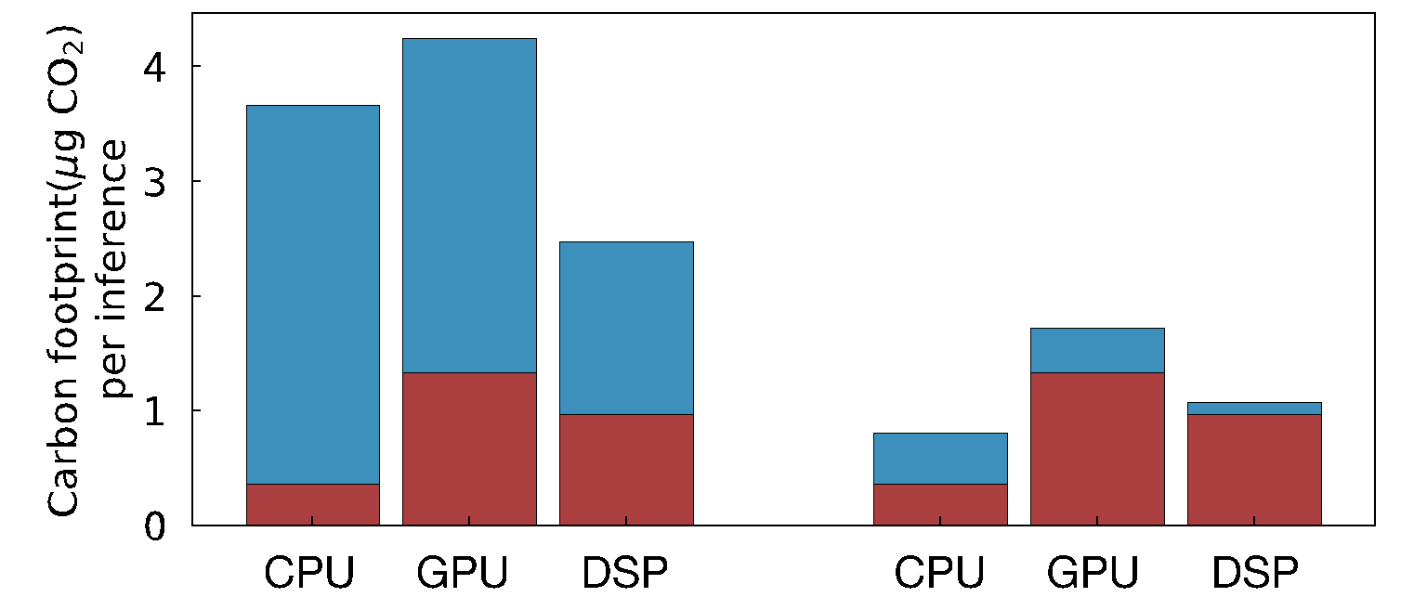
Reuse: General purpose versus custom mobile HW
AI inference case study (MobileNet) assuming 3 year hardware lifetime, and same utilization in all cases
Commodity (mobile CPU)
Specialized (mobile GPU, DSP)
Architectural
Carbon Model
Carbon per inference
Without renewables
during operation
With renewables
during operation

Slide 68
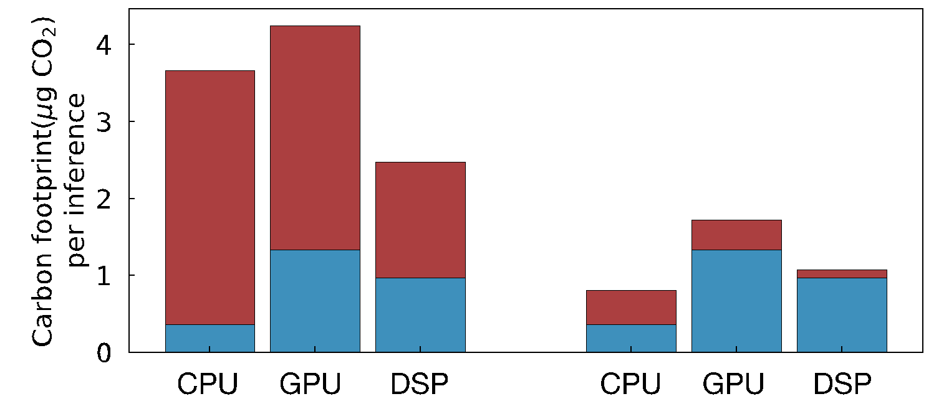
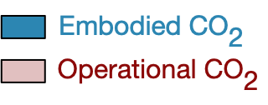
Reuse: General purpose versus custom mobile HW
AI inference case study (MobileNet) assuming 3 year hardware lifetime, and same utilization in all cases
Commodity (mobile CPU)
Specialized (mobile GPU, DSP)
Architectural
Carbon Model
Carbon per inference
DSP
optimal
Without renewables
during operation
With renewables
during operation

Slide 69
Reuse: General purpose versus custom mobile HW
AI inference case study (MobileNet) assuming 3 year hardware lifetime, and same utilization in all cases
Commodity (mobile CPU)
Specialized (mobile GPU, DSP)
Architectural
Carbon Model
Carbon per inference
DSP
optimal
Without renewables
during operation
With renewables
during operation

Slide 70
Reuse: General purpose versus custom mobile HW
AI inference case study (MobileNet) assuming 3 year hardware lifetime, and same utilization in all cases
Commodity (mobile CPU)
Specialized (mobile GPU, DSP)
Architectural
Carbon Model
Carbon per inference
DSP
optimal
CPU
optimal
3x reduction
Without renewables
during operation
With renewables
during operation

Slide 71
Tenets of Environmental Design
Reduce
Design leaner footprint software and hardware.
Recycle
Reuse
Recover discarded systems and components.
Repurpose systems already produce.

Slide 72
Reduce: Designing leaner hardware systems
Architectural
Carbon Model
Performance/energy vs.
Carbon
Nvidia DL Accelerator (NVDLA)

Slide 73
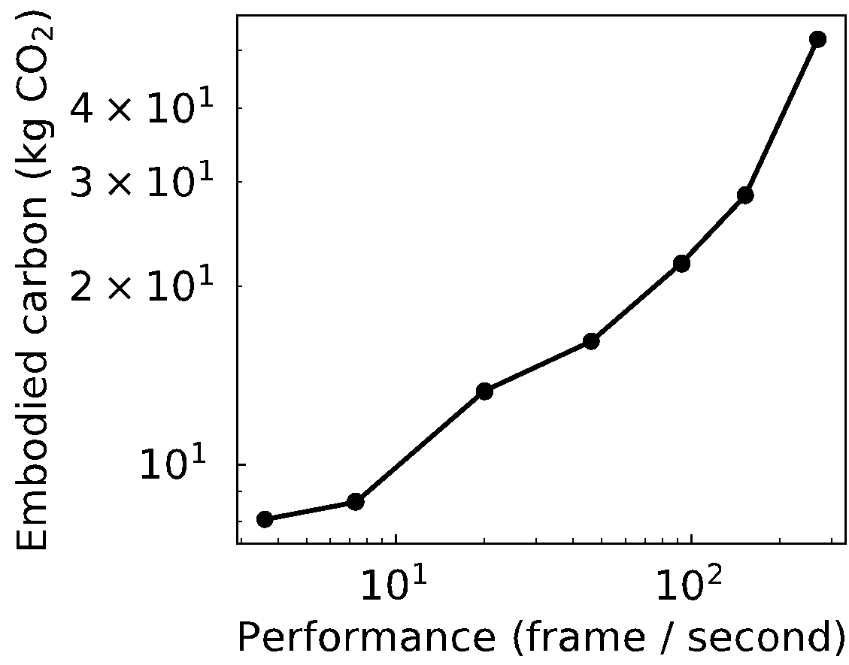
Reduce: Designing leaner hardware systems
Architectural
Carbon Model
Performance/energy vs.
Carbon
Nvidia DL Accelerator (NVDLA)
30 FPS target
30 FPS target

Slide 74
Reduce: Designing leaner hardware systems
Architectural
Carbon Model
Performance/energy vs.
Carbon
Nvidia DL Accelerator (NVDLA)
30 FPS target

Slide 75
Reduce: Designing leaner hardware systems
Architectural
Carbon Model
Performance/energy vs.
Carbon
Nvidia DL Accelerator (NVDLA)
Performance
opt.
Energy
opt.
30 FPS target

Slide 76
Reduce: Designing leaner hardware systems
Architectural
Carbon Model
Performance/energy vs.
Carbon
Nvidia DL Accelerator (NVDLA)
Performance
opt.
3x carbon decrease!
CO₂ opt.
Energy
opt.
30 FPS target

Slide 77
Today
Where does computing’s carbon footprint come from?
A combination of both energy consumed and hardware manufacturing (embodied carbon).
Application
Mobile
Data center
Understanding the source of computing’s emissions
Tackling computing’s emissions bottom up: architectural carbon models
Tackling computing’s emissions top down: enabling sustainable AI
How can we curve computing’s emissions and enable sustainable computing (going beyond efficiency optimizations)?
Fabs
Notes:
Finally, given our understanding of carbon emissions, we will conclude by charting paths for how to design future sustainable computing systems.

Slide 78







Computing incurs a growing environmental footprint
1.2-2.2 Billion tons of CO₂
Data center
Mobile
Communication
59% of world online
Future improvements challenging (e.g., slowing Moore’s law)
Emerging applications demanding higher compute
Notes:
When we aggregate computing environmental impact across mobile, communication, and data centers, studies show that computing accounts for 900 million metric tons of CO2.
That’s on par with the aviation industry’s footprint and around 2-4% of worldwide emissions.
Not only is this a huge amount already but we find that ICT emissions are expected to double over the next decade given the growing demand for computing.
And so it’s crucial that we as a community start think about what it means for computing itself to be sustainable.

Slide 79
AI growth imposes high infrastructure costs
Data center
Mobile
AI accounts for ~15% of Google’s data center
Training and inference in Meta’s data center grown by 3x capacity in 2 years
Data capacity doubled in Meta’s data center
Mobile systems have dedicated bionic accelerators accounting for ¼ of SoC area

Slide 80
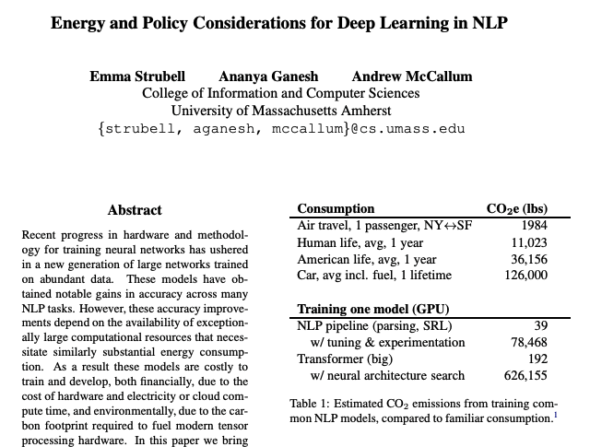
Growing literature quantifying AI emissions

Slide 81
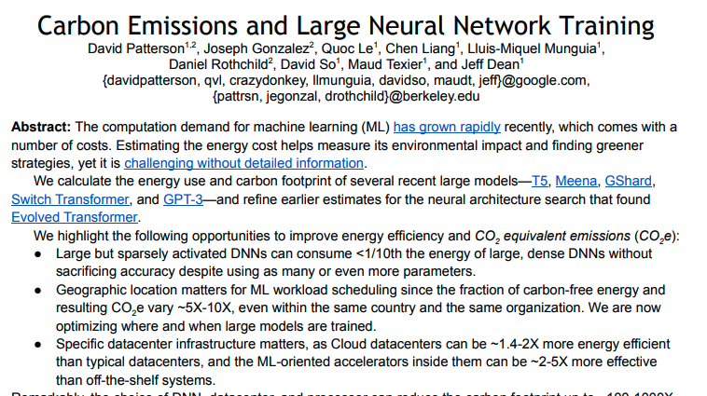
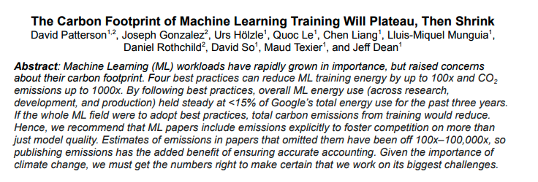
Growing literature quantifying AI emissions

Slide 82

Machine learning life cycle
Training and experimentation
(29%)
Wu et. al. Sustainable AI: Environmental Implications, Challenges, and Opportunities (MLSys 2022)

Slide 83
Crucial to look at emissions across ML cycle
Machine learning life cycle
Training and experimentation
(29%)
Data
Collection (31%)
Inference
(40%)
Wu et. al. Sustainable AI: Environmental Implications, Challenges, and Opportunities (MLSys 2022)

Slide 84
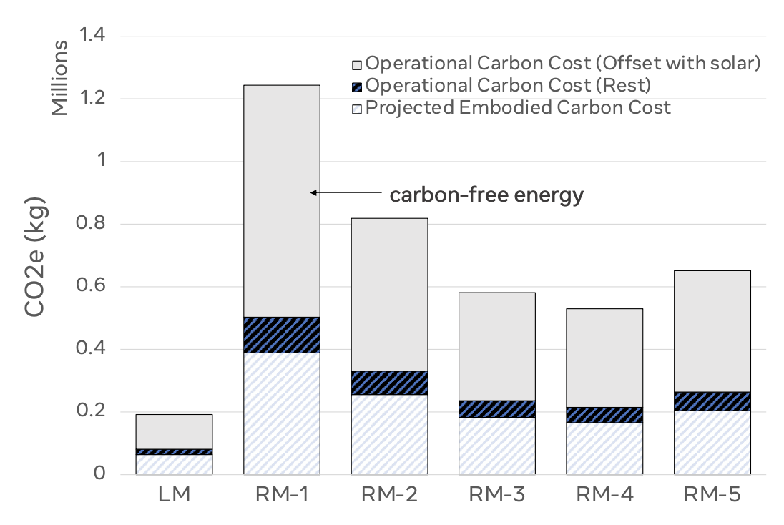
Crucial to look at emissions across HW cycle

Slide 85
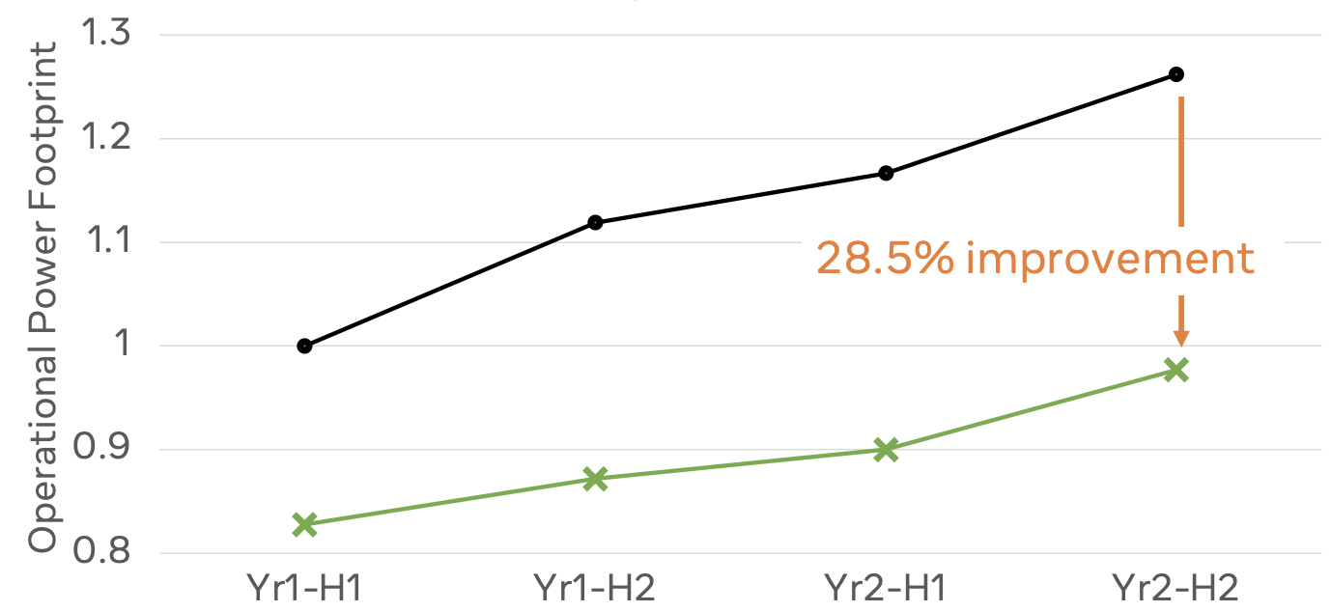
Jevon’s paradox of AI at-scale
Baseline AI power capacity (Meta)
Optimized power capacity

Slide 86
Today
Where does computing’s carbon footprint come from?
A combination of both energy consumed and hardware manufacturing (embodied carbon).
Application
Mobile
Data center
Understanding the source of computing’s emissions
Tackling computing’s emissions bottom up: architectural carbon models
Tackling computing’s emissions top down: enabling sustainable AI
How can we curve computing’s emissions and enable sustainable computing (going beyond efficiency optimizations)?
Fabs
Notes:
Finally, given our understanding of carbon emissions, we will conclude by charting paths for how to design future sustainable computing systems.

Slide 87
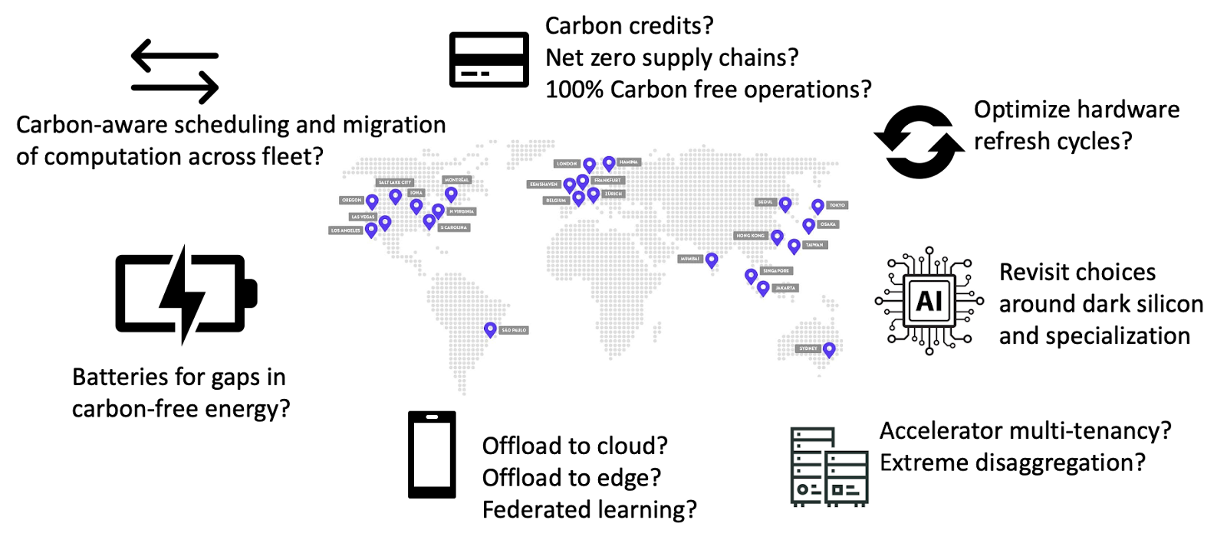
Global-Scale Carbon Optimization

Slide 88
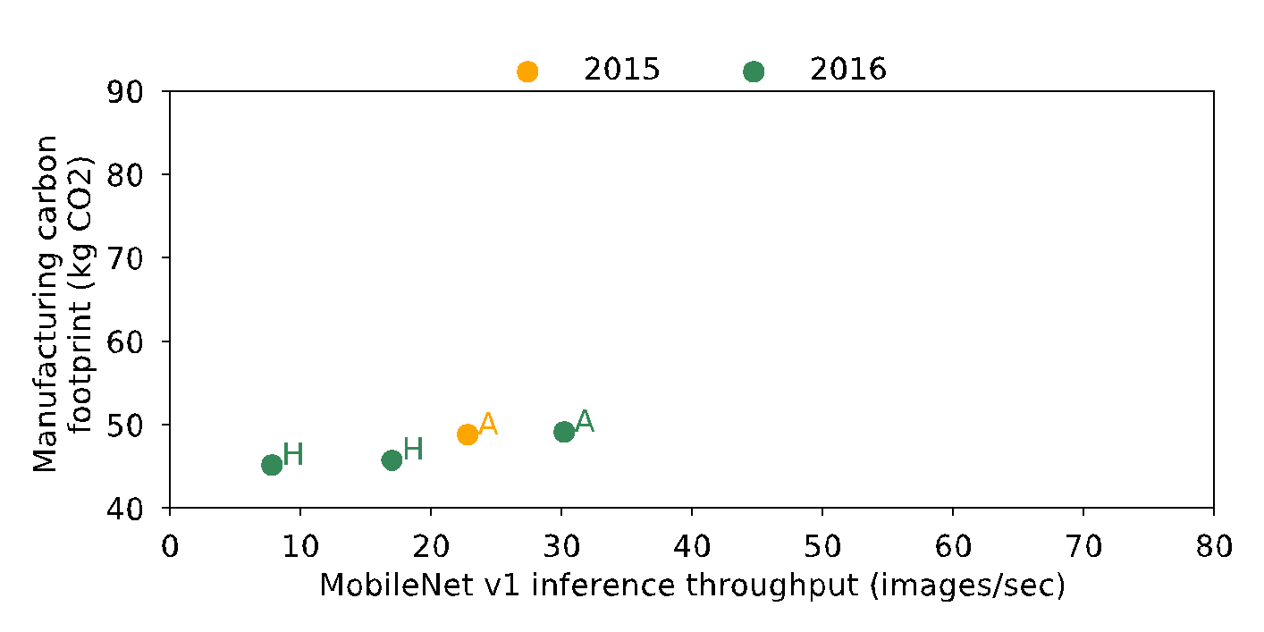
Performance versus manufacturing footprint
Data from industry (Apple, Google, Huawei) life cycle analyses and GeekBench performance measurements https://www.geekbench.com/blog/2019/09/geekbench-5/
Notes:
Here we study the tradeoff between performance and manufacturing related carbon emissions.
On the x-axis we have mobile Net v1 inference throughput gathered from Geekbench measurements.
On the y-axis we have manufacturing-related emissions gathered from publicly available sustainability reports from LCAs of devices with 128 GB capacity.
In yellow and green we have example mobile devices from 2015 and 2016.
H denotes devices from Huawei and A from apple.

Slide 89
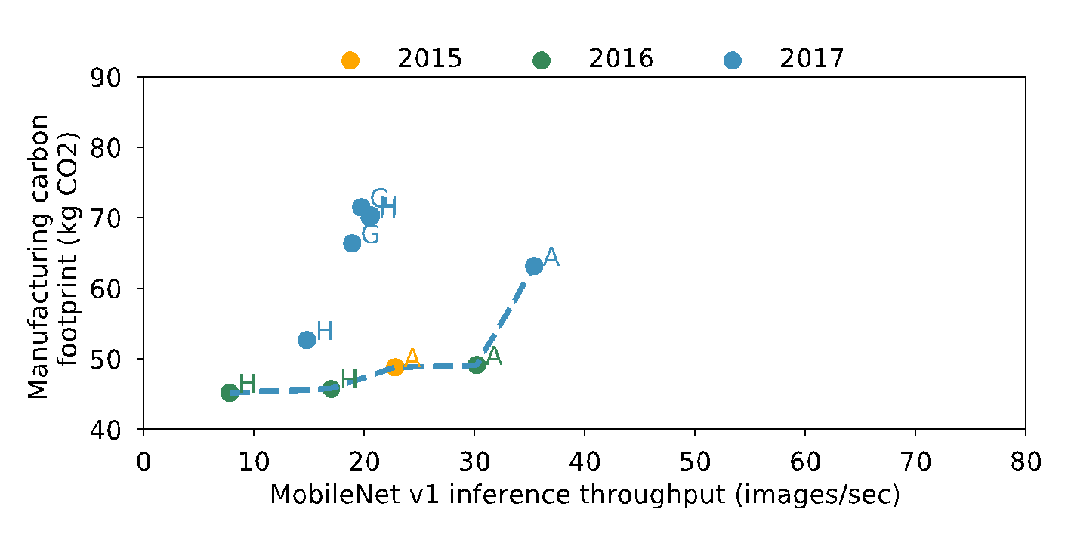
Performance versus manufacturing footprint
Data from industry (Apple, Google, Huawei) life cycle analyses and GeekBench performance measurements https://www.geekbench.com/blog/2019/09/geekbench-5/
Notes:
Adding 2017 in blue, we find a pareto curve forming between mobile performance and manufacturing related carbon emissions.

Slide 90
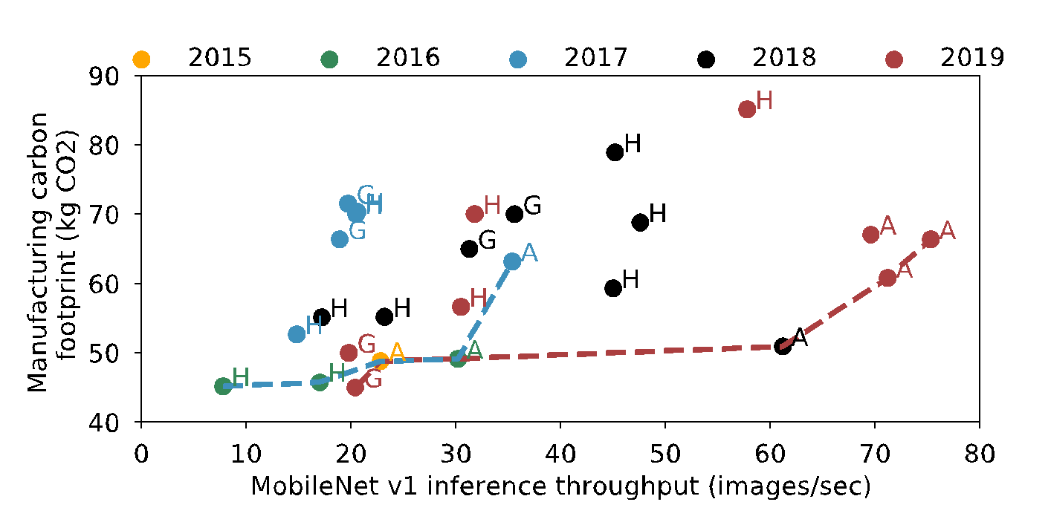
Performance versus manufacturing footprint
Data from industry (Apple, Google, Huawei) life cycle analyses and GeekBench performance measurements https://www.geekbench.com/blog/2019/09/geekbench-5/
Performance and efficiency improvement
Between 2017 and 2019 the Pareto frontier has shifted to the right prioritizing performance.
Designing sustainable systems requires shifting the frontier down.
Notes:
Further analyzing devices from 2018 in black and 2019 in red, we find that the Pareto-frontier from 2017 and 2019 shifted strictly to the right.
As a result, while performance has improved, carbon footprint has not.
These performance advantages are a result of both algorithm and hardware improvements.
Moving forward we need to think about ways to not only shift this Pareto to the right, but also downwards to lower emissions.
This includes carbon-aware resource provisioning and increasing the lifetime of hardware used.

Slide 91
Performance versus manufacturing footprint
Data from industry (Apple, Google, Huawei) life cycle analyses and GeekBench performance measurements https://www.geekbench.com/blog/2019/09/geekbench-5/
Performance and efficiency improvement
Between 2017 and 2019 the Pareto frontier has shifted to the right prioritizing performance.
Designing sustainable systems requires shifting the frontier down.
Notes:
In fact, in the paper we show that it takes over 3 years of continuously running AI inferences on a Pixel 3 phone for the carbon footprint from energy consumption to equal that of hardware manufacturing.
3 years is the average life time of our mobile phones!
This highlights the need to extend hardware lifetimes through increased reliability and future proofing hardware to provide sufficient performance on emerging applications.
More generally, lower footprint devices are crucial towards a sustainable computing future.

Slide 92
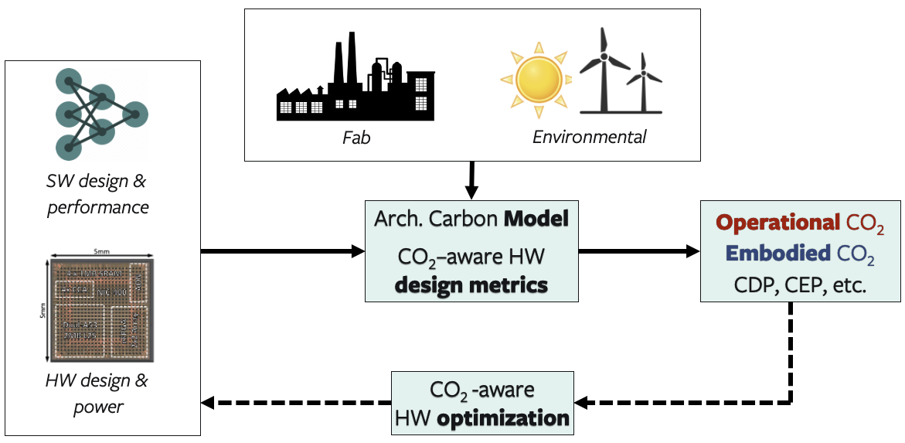
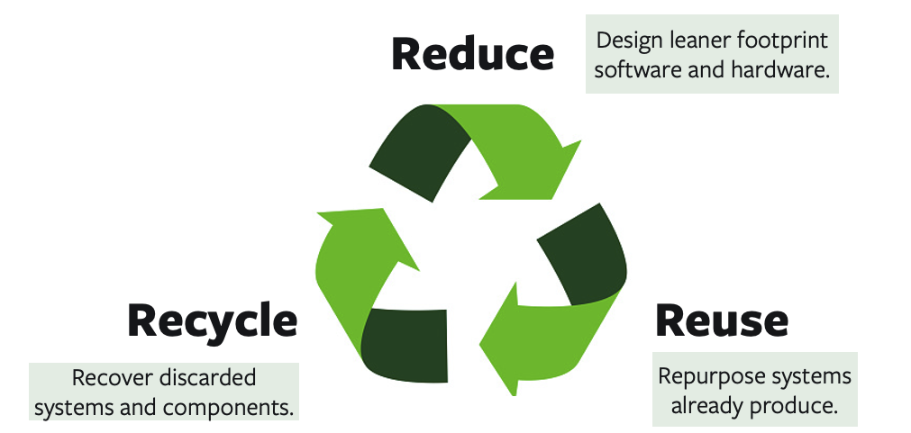
This work: ACT
Develop the model
Case studies

Slide 93
This work: ACT
Develop the model
Case studies
More details in the paper!
Modeling parameters and industry sources for data
Carbon-aware metrics for early DSE (e.g., EDP, CDP, CEP)
Detailed comparison against industry LCA’s
Reuse case study: impact of reconfigurable accelerators (FPGA’s)
Recycle case study: Enabling second life & SSD provisioning

Slide 94
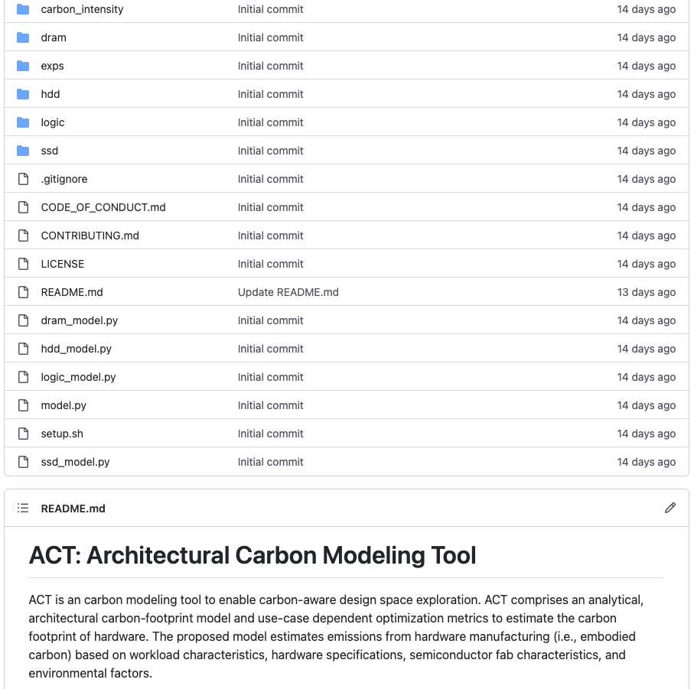

This work: ACT
Develop the model
Case studies
Open-source!
More details in the paper!
Modeling parameters and industry sources for data
Carbon-aware metrics for early DSE (e.g., EDP, CDP, CEP)
Detailed comparison against industry LCA’s
Reuse case study: impact of reconfigurable accelerators (FPGA’s)
Recycle case study: Enabling second life & SSD provisioning

Slide 95
Thank you!
This work: ACT
Develop the model
Case studies
Open-source!
More details in the paper!
Modeling parameters and industry sources for data
Carbon-aware metrics for early DSE (e.g., EDP, CDP, CEP)
Detailed comparison against industry LCA’s
Reuse case study: impact of reconfigurable accelerators (FPGA’s)
Recycle case study: Enabling second life & SSD provisioning

Slide 96
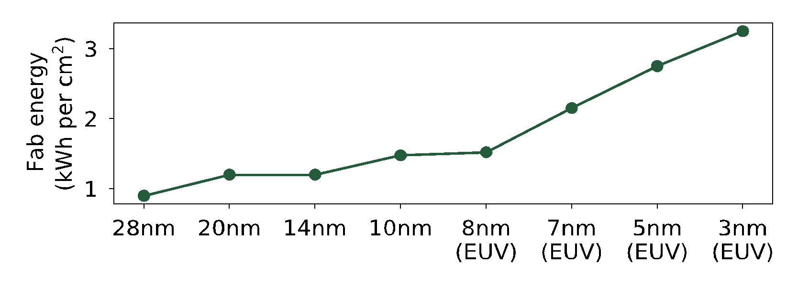
Embodied carbon of application processors (SoC’s)
Fab energy increases over tech. nodes
DTCO including Sustainability: Power-Performance-Area-Cost-Environmental score (PPACE) Analysis for Logic Technologies. Bardon et. al (IEDM 2020)

Slide 97
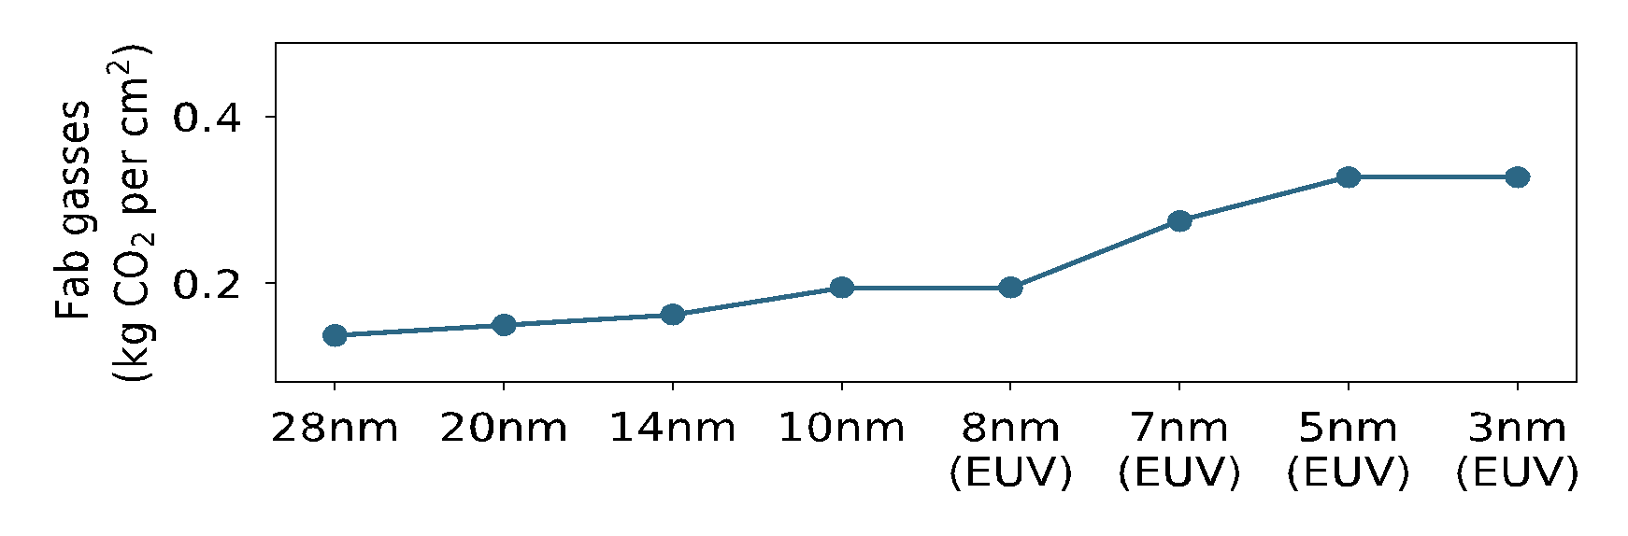
Embodied carbon of application processors (SoC’s)
Fab energy increases over tech. nodes
95% abatement
TSMC (97%)
99% abatement
DTCO including Sustainability: Power-Performance-Area-Cost-Environmental score (PPACE) Analysis for Logic Technologies. Bardon et. al (IEDM 2020)

Slide 98
DRAM carbon per storage model
Data sources: SK Hynix
Notes:
Just this section is around 8:30min

Slide 99
SSD carbon per storage model
Data sources: SK Hynix, Apple
Notes:
Just this section is around 8:30min

Slide 100
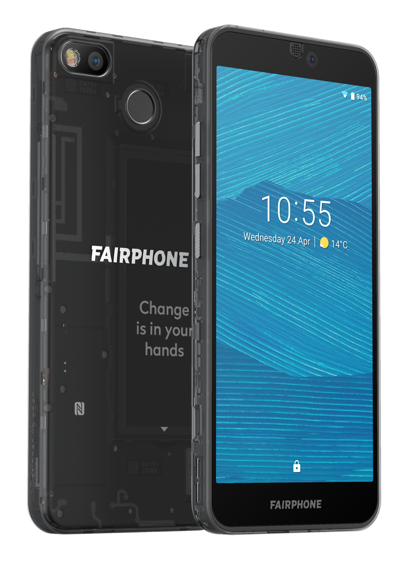
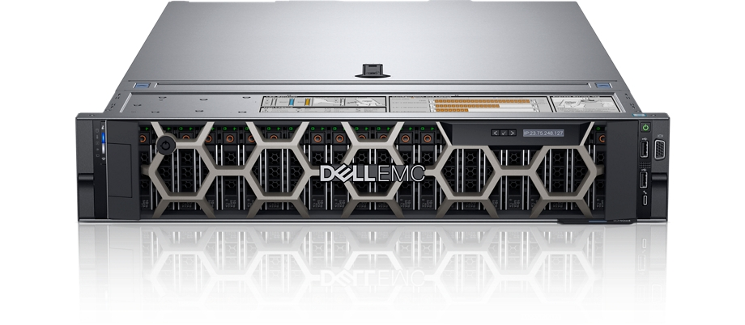
More comparisons (ACT vs. LCA’s) in the paper…
 | ACT vs. Dell R740 server LCA | ACT vs. Fairphone 3 mobile device LCA

Slide 101
More comparisons (ACT vs. LCA’s) in the paper…
IC component | ACT vs. Dell R740 server LCA | ACT vs. Fairphone 3 mobile device LCA
Compute (processors, SoC’s) | Within 2.2x | Within 1.18x
Memory | Within 1.62x | Within 2.1x
Storage | Within 1.05-2.2x
Takeaways
ACT provides first-order approximate of LCA’s that use old technology nodes (45nm NAND, 32nm CPU)
ACT enables architects to study new technology nodes

Slide 102
Recycle: Extending hardware lifetime
Mobile SoC’s
Geekbench characterization
Architectural
Carbon Model
Operational vs.
Embodied carbon

Slide 103
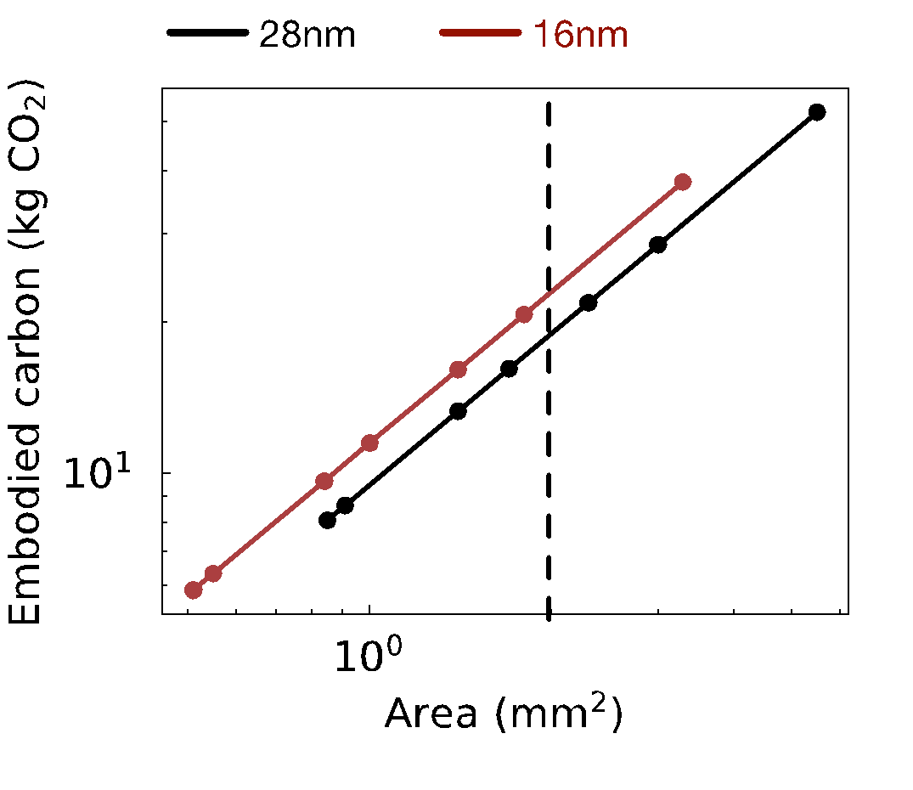
Reduce: Designing leaner hardware systems
Architectural
Carbon Model
Performance/energy vs.
Carbon
Nvidia DL Accelerator (NVDLA)
Performance
opt.
3x carbon decrease!
CO₂ opt.
Energy
opt.
30 FPS target
2mm² area

Slide 104
Reduce: Designing leaner hardware systems
Architectural
Carbon Model
Performance/energy vs.
Carbon
Nvidia DL Accelerator (NVDLA)
Performance
opt.
3x carbon decrease!
CO₂ opt.
Energy
opt.
30 FPS target
2mm² area

Slide 105
Reduce: Designing leaner hardware systems
Architectural
Carbon Model
Performance/energy vs.
Carbon
Nvidia DL Accelerator (NVDLA)
Performance
opt.
3x carbon decrease!
30% carbon increase
(Jevon’s paradox)
CO₂ opt.
Energy
opt.
30 FPS target
2mm² area

Slide 106
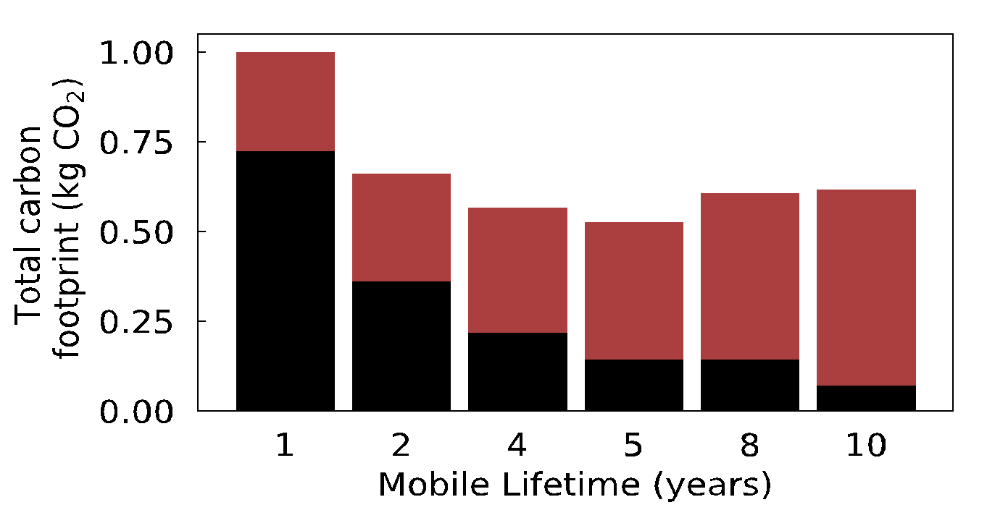
Recycle: Extending hardware lifetime
Mobile SoC’s
Geekbench characterization
Architectural
Carbon Model
Operational vs.
Embodied carbon
Embodied CO₂
Operational CO₂

Slide 107
Recycle: Extending hardware lifetime
Mobile SoC’s
Geekbench characterization
Architectural
Carbon Model
Operational vs.
Embodied carbon
Embodied CO₂
Operational CO₂
Embodied
reduction
Operational
degradation

Slide 108
Recycle: Extending hardware lifetime
Mobile SoC’s
Geekbench characterization
Architectural
Carbon Model
Operational vs.
Embodied carbon
Embodied CO₂
Operational CO₂
Embodied
reduction
Operational
degradation
Enabling 2nd life
requires enhancing
HW reliability
See paper for case
study on storage
reliability using
SSD overprovisioning

